Slide 1
Introduction to Computer Science
Lecure2_Part1

Slide 2
Computer components

Slide 3
OBJECTIVES AND INTENDED OUTCOMES
By the end of this lesson the learner is expected to:
Understand the concept of processor and processing.
Learn the function of Central Processing Unit )CPU).
Learn the function of control unit, and Arithmetic and Logic unit.
Learn the compare between RAM and ROM.
Understand how a CPU works.
Understand the concept of the main storage unit and secondary storage units.
Learn about the different types of secondary storage units.
Learn about the storage.

Slide 4
Computer components

Slide 5
Computer Components
Hardware
Software

Slide 6

Hardware
Memory
Central Processing Unit
CPU
Output Unit
Input Unit
Storage Units

Slide 7
Software
divided into :
Systems software
Application software.

Slide 8
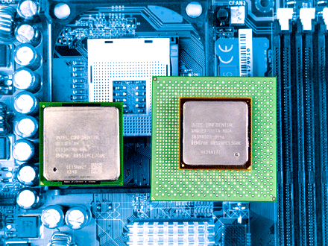
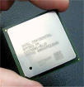
Central Processing Unit
The main components of a computer. It is a chip consisting of a large number of electronic circuits made of silicon.
Its tasks:
Data analysis.
Sending instructions to the rest of the computer.
Carry out instructions.
Control of inputs and outputs.

Slide 9
Central Processing Unit
components
Central Processing Unit
Arithmetic and
Logic (ALU)
Control unit
( CU )
It performs all arithmetic and logical operations.
It controls all parts of the computer and delivers instructions from one part to another.
The faster computer, the higher processor speed
Computer speed is measured in megahertz (MHz).

Slide 10
Central Processing Unit
The processor capacity can be measured by the temporal speed: which refers to the number of operations that the processor performs per second and is measured in megahertz.
The processor communicates physically with other parts of the computer through three types of buses :
Data Buses: Transfer data across the various units of the computer
Addressing Buses : Transfer the addresses of the main memory cells specified in the processor
Control Buses: Transfer commands to the console

Slide 11
Arithmetic and Logic (ALU)
The ALU needs data to process it and instructions that specify the type of processing required, and the ALU gets that from the main memory and uses the main memory in four basic activities:
Store the entered.
Store the interim results of operations.
Store the final results of the operation.
Store operations and operating orders.

Slide 12
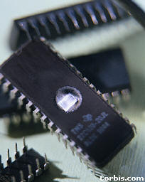
Computer Memory
Read Only Memory (ROM):
A computer memory that stores operating instructions for the device.
It is permanent and cannot be erased or written on.
set by the device manufacturer.
Random Access Memory (RAM):
Memory starts with the computer running.
Temporary can be erased and written to.
Data is lost in the event of a power outage.
It is the mediator between the CPU and storage units.

Slide 13
Difference between RAM & ROM
RAM | ROM
More storage capacity | Limited storage capacity | Capacity
temporary | permanent | Storage Type
programs and user data | CPU instructions | Contents
At what time | Once when setting up the device | Writing
At what time | every time you turn on the device | reading

Slide 14
secondary storage units
Hard Disk:
Huge storage capacity.
High speed access to the data stored in it.
It is usually installed in the device and may be connected from the outside.
Floppy Disk:
Limited storage capacity of 1.4MB, low cost.
Flash Memory:
It has the ability to connect externally.
With large storage capabilities.
High cost.
CD-ROM:
The data is stored using a laser.
The storage capacity of DVD discs is up to a number of gigabytes.

Slide 15
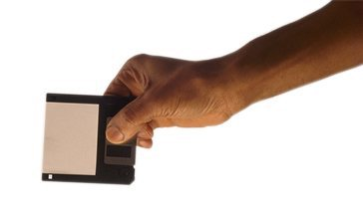
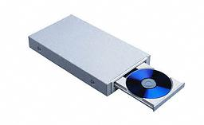
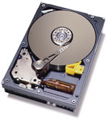

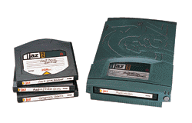
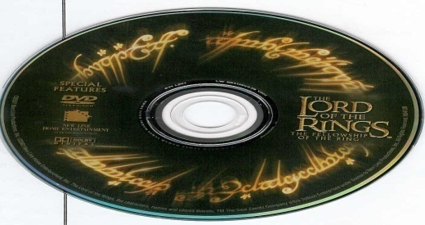
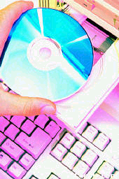
secondary storage

Slide 16
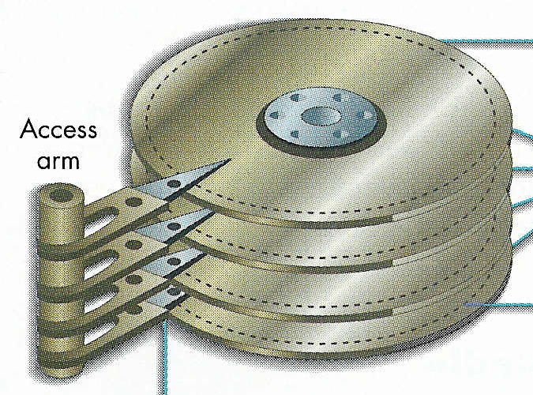
Hard Disk
These discs are stored magnetically.

Slide 17
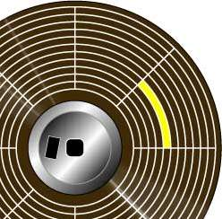
Floppy Disk
In the past, it was the most used storage unit, now it has been replaced by other storage unit.
It is symbolized by (A).

Slide 18

Optical Disk
A technology that uses laser beams for storage.
Now Read-Write discs.

Slide 19

DVD
A technology that uses laser beams for storage.
Its capacity is 6 times greater than the CD.

Slide 20



Flash Memory

Slide 21
Introduction to Computer Science
Lecure2_Part2

Slide 22
Computer components

Slide 23
OBJECTIVES AND INTENDED OUTCOMES
By the end of this lesson the learner is expected to:
Understand the concept of the input and output devices.
Learn the function of input and output devices.
Learn the compare between deferent input and output devices.
Understand the appropriate way to enter and show various data.

Slide 24
Input Unit
Input units are mainly based on linking computer users to the computers themselves, as they are responsible for entering data and programs into the computer's memory, and they send those entered data to the computer in a language readable by the computer itself.

Slide 25
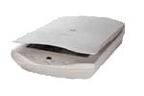
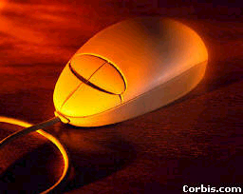
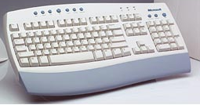

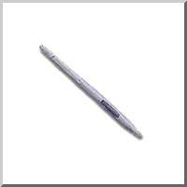
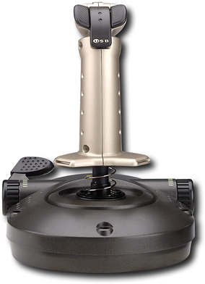
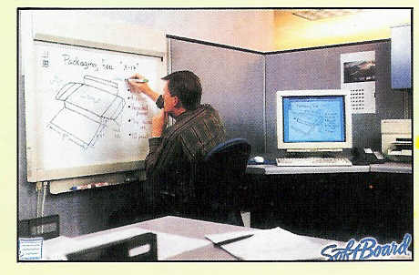
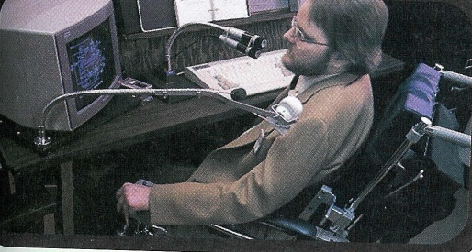
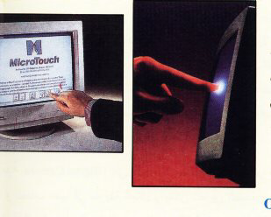
Input Unit

Slide 26
Output Unit
The output units that receive the results and display them in different forms.

Slide 27

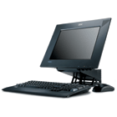
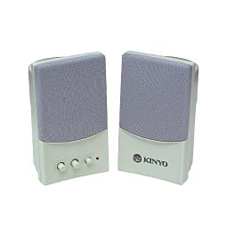
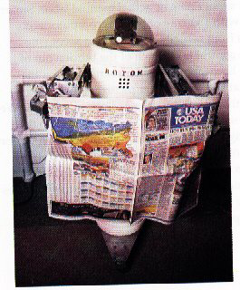
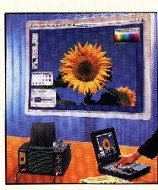
Output Unit

Slide 28
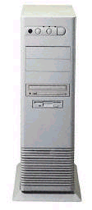
system Box
The system box contains most of the computer's units.
Connect to other computer units. Its most important parts:
Motherboard
Ports
Power Supply

Slide 29
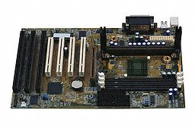
Motherboard

Slide 30
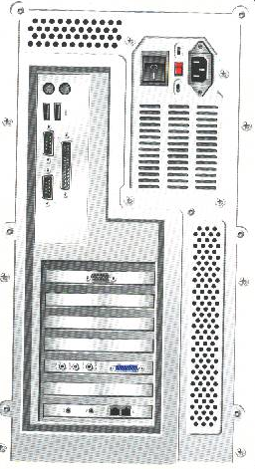
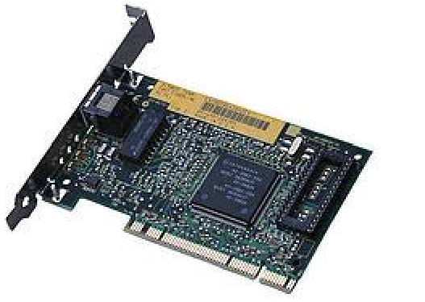
Ports
Parallel ports > Printer, Serial ports > Mouse, USB ports.
Expansion ports.

Slide 31
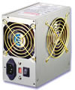
Power Supply
Supplying the computer with electricity.
There is a fan to reduce the heat of the generator.

Slide 32
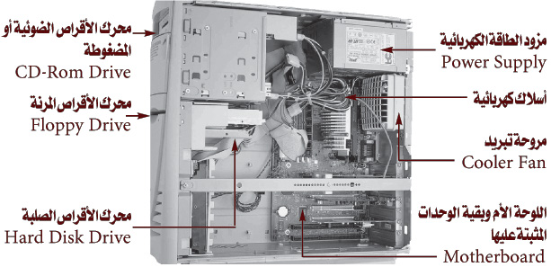
HW Components

Slide 33
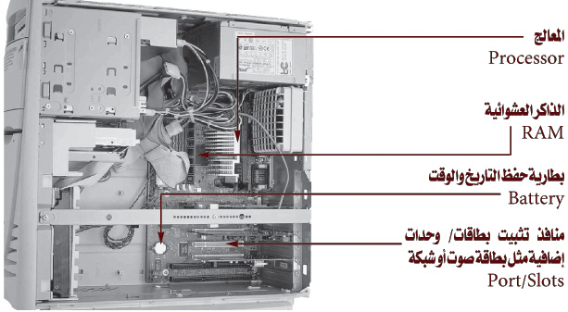
HW Components

